Slide 1
Programming Fundamentals
by Abeeha Sattar

Slide 2
Nested Switches
It’s normal switch cases, but… nested…!
Let’s code that real quick… Here’s a little scenario…
Imagine you are working on a small warehouse sorting system. The warehouse uses numeric codes for categories of items (numCode) and letter codes for item labels (letterCode).
The numeric code (numCode) tells us which main category the item belongs to:
0 → Category A
1 → Category B
2 → Category C
The letter code (letterCode) gives more details about the item within that category:
For Category A (0), we expect items that start with 'z'.
For Category B (1), we expect items that start with 'o'.
For Category C (2), we expect items that start with 't'.
Notes:
#include <stdio.h>
int main() {
// try value combinations 0-z, 1-o and 2-t to see everything work.
// can try random values too if you want!
int numCode = 2;
char letterCode = 't';
//outer switch
switch(numCode) {
case 0:
printf("This one was 0\n");
//inner switch - nested within the outer switch
//note how we use indentation for visual clarity
// try removing and the indenation and notice how the code still works fine...
//... but it's harder to see which switch is an inner switch
switch (letterCode) {
case 'z':
printf("That one starts with 'z'\n");
break;
default:
printf("That one doesn't start with 'z'\n");
}
break;
case 1:
printf("This one was 1\n");
switch (letterCode) {
case 'o':
printf("That one starts with 'o'\n");
break;
default:
printf("That one doesn't start with 'o'\n");
}
break;
case 2:
printf("This one was 2\n");
switch (letterCode) {
case 't':
printf("That one starts with 't'\n");
break;
default:
printf("That one doesn't start with 't'\n");
}
break;
default:
printf("Not 0, 1 or 2");
}
return 0;
}

Slide 3
Loops
There are 3 types of loops in C.
For
While
Do-While
Each loop has a type
Entry Controlled : the test condition is verified before entering the loop. For and While loops do this.
Exit Controlled : the test condition is verified after the content of the loop is executed. Do-While loop does this.

Slide 4
For Loop - Syntax
for (initialize loop var; condition; update loop var) {
// body of for loop
}
Example:
for (int i = 0; i < 10; i++) {
printf( "i is %d\n", i);
}

Slide 5
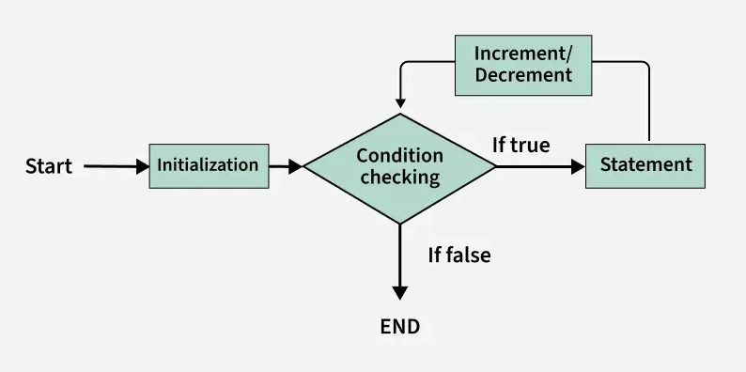
Flowchart for “for” Loop
Notes:
https://www.geeksforgeeks.org/c/c-loops/

Slide 6
While loop
while (condition) {
// Body of the loop
}
Example:
int i = 0;
while (i < 10) {
printf( "i is %d\n", i);
i++;
}

Slide 7
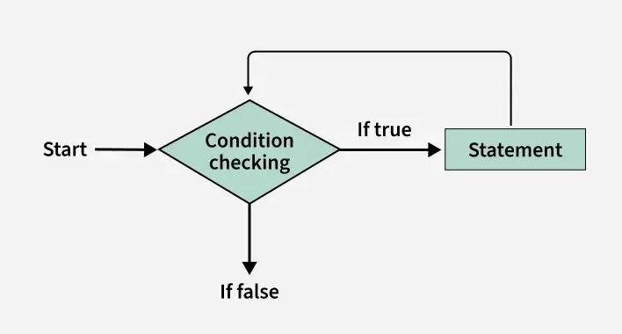
Flowchart for “while” Loop

Slide 8
Do-While Loop
do {
// Body of the loop
} while (condition);
Example:
int i = 0;
do {
printf( "i is %d\n", i);
i++;
} while (i < 10);

Slide 9
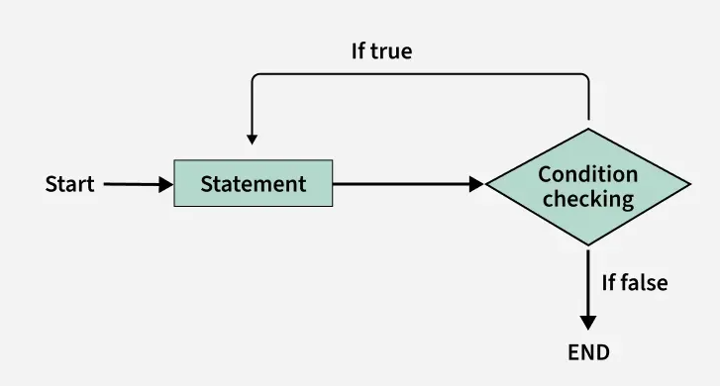
Flowchart for “do-while” Loop

Slide 10
Practice Problems:
The classic ol’ multiplication table: Ask the user which table they want to see printed. Then print the table for that number, up until 10 times.
Ask the user for a number, print the sum of all odd numbers, and the sum of all even numbers until that number. (inclusive of that number, ensure positive number)
Ask the user to input a decimal number in between 1-100. If they fail to input the number within the range, they must input the value again. Convert the provided number into its binary equivalent.
Ask the user to input a binary number (store it as in integer). Validate whether the provided number is binary or not.
Convert the binary number into its decimal equivalent. (Hint: you may use the library “math.h”, it has functions pow(x, y) - returns x^{y} and exp2(x) - returns 2^{x})
You can also do it without using the library! (you actually don’t need it)

Slide 11
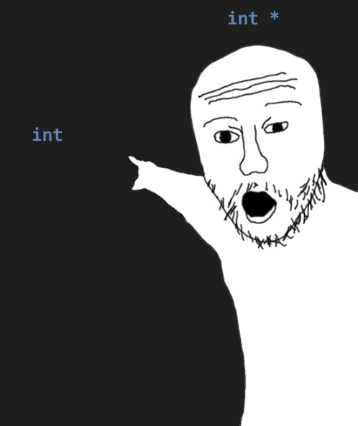
Pointers – Probably the Bane of Your Existence
It’s a variable
It stores the memory address of another variable
int var = 10;
int* ptr = &var;
printf("%d", ptr);
printf("%d", *ptr);
Now this was just an example using integers. You can make char*, float*, double* as well!

Slide 12
Referencing & De-referencing
In the previous example:
& - or the “address of” operator is used to “reference” the memory of the variable ‘var’
int* ptr = &var;
* - or the dereference operator is used to “extract”/“dereference” the value of the variable ‘var’;
printf("%d", *ptr);
You can also use it as this:
int IGotThisValue = *ptr; //dereferencing value being pointed to by ptr.

Slide 13
Let’s try some things out!
int *ptr; int var = 10; ptr = &var; int v2 = *ptr;
printf("var: %d, v2:%d, ptr:%d, *ptr:%d\n", var, v2, ptr, *ptr);
var+=10;
printf("var: %d, v2:%d, ptr:%d, *ptr:%d\n", var, v2, ptr, *ptr);
*ptr+=10;
printf("var: %d, v2:%d, ptr:%d, *ptr:%d\n", var, v2, ptr, *ptr);
ptr+=10;
printf("var: %d, v2:%d, ptr:%d, *ptr:%d\n", var, v2, ptr, *ptr);

Slide 14
Types of Pointers
NULL pointer – points to “nothing”
int* ptr = NULL;
Void pointer – can point to anything
void* ptr;
vptr = &var;
printf("%d, %d", vptr, *(int*)vptr); //dereferencing it is a bit… weird… it’ll make sense when we learn more about type casting.
Wild Pointer – a pointer that has not been initialized yet
Dangling Pointer – A pointer pointing to a memory location that has been freed. This will become relevant later, when we learn about dynamic memory allocation.

Slide 15
Arrays
A “data structure” that contains a collection of elements.
An array must have:
Homogenous Elements: Every element is the same data type
Contiguous Memory Allocation: The memory allocation is sequential
(usually) Fixed Size: e.g., an array of size 10 can hold 10 elements.
Access by Index: Since the memory allocation is sequential, you can access each element using the index.
The indices start at 0, and go until n-1.
For an array of 10 elements, the indices will start at 0, and go till 9.
Notes:
What’s a data structure?
A specific way of organizing data in a specialized format on a computer so that the information can be organized, processed, stored, and retrieved quickly and effectively

Slide 16
Why arrays?
Remember your assignment…?
You had to make so many variables to store information regarding one type of thing.
Arrays help us make fewer variables, store similar information together in a structured way… and will become even more important when we work with loops.

Slide 17
Syntax for Array Declaration
Following code will create and array of 5 integers.
int ages[5];
Let’s say I want to modify a value in the array…
int ages[0] = 10; //changes value of index 0 of ages to 10.
Can declare and initialize at the same time, like:
int wow[5] = {1, 2, 3, 4, 5};

Slide 18
Subscript Operator – [ ]
The subscript operator is used to access elements in an array by index (as we saw earlier)
So how does it work in the background?
It’s also performing dereferencing like how * does.
arrInt[0] is equivalent to *(arrInt + 0) or *(arrInt)
arrInt[2] is equivalent to *(arrInt + 2)
Keep in mind that arrInt != arrInt[0]
arrInt is the address of the first index (the 0th Index)
arrInt[0] is the value that is being returned after dereferencing

Slide 19
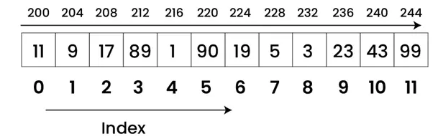
Some visual representation
If the base address of an array is 200
Each integer occupies 4 bytes
Then the second element will be stored at 204, the third at 208, and so on
Image is courtesy of: https://iies.in/blog/memory-representation-and-declaration-of-arrays/(You can go read up on things here too!)
Notes:
Images courtesy of: https://iies.in/blog/memory-representation-and-declaration-of-arrays/

Slide 20
Loops and Arrays
Instead of accessing each element in a separate line, like:
arrInt[0] = 0;
arrInt[1] = 1;
arrInt[2] = 2;
arrInt[3] = 3;
arrInt[4] = 4;
You can do something like this instead:
for (int i=0; i<5; i++) {
arrInt[i] = i;
}

Slide 21
Now then, let’s do some useful stuff!
Write a program where the user is prompted to input marks for 5 courses. (assume out of 100)
Store marks for each course in an array.
Do the following:
Calculate the average marks.
Calculate the percentage per course, and the overall percentage.
Find out which course had the highest marks.
Find out which course had the lowest marks.
Bonus: Try sorting the array…

Slide 22
Practice Problems for Homework
Reverse the elements of an array (5 elements). Try it using these two ways.
Create a second array which contains the reversed elements.
Reverse the array without creating a second array.
Ask the user to input random numbers and store them in an array of size 10.
Check if the array is in ascending order.
Check if the array is in descending order.
Find the second largest number in the array.
Count the number of positive and negative numbers in the array. (treat zero as positive for now)
Ask the user to input a character ‘L’ or ‘R’. If the input is L shift all the elements of the array leftwards by 1. The element on 0th index will move to the 9th index instead, Similarly, if the input is R, shift all elements rightwards by 1. The element on the 9th index will move the 0th index. You may use temp variables for this.

Slide 23
Strings – or Character Arrays
char arr[10];
scanf("%c", &arr[0]);
printf("%c\n", arr[0]);
scanf("%s", arr); //reading a whole string as input. Why no & here?
printf("%s\n", arr); //displaying the whole string

Slide 24
The Null Character / String Terminator
Remember ‘\0’?
That’s the null character. It exists at the end of a string to tell the program to stop reading after that point. (hence string terminator)

Slide 25
sizeof() – function – works on other arrays too.
It returns the size of the array.
char uni[] = "FAST"; //note how we didn't specify a size here
printf("%s, %d\n", uni, sizeof(uni));
char name[] = {'Y','o','u','r',' ','n','a','m','e',' ','h','e','r','e'};
printf("%s, %d\n", name, sizeof(name));
char name2[] = {'Y','o','u','r',' ','n','a','m','e'};
printf("%s, %d\n", name2, sizeof(name2));
char name3[] = {'Y','o','u','r',' ','n','a','m','e','\0'};
printf("%s, %d\n", name3, sizeof(name3));

Slide 26
Now let’s try out some stuff
char myStr[] = “the quick brown fox jumped over the lazy dog”;
For the above string:
Find out the count for all the ‘a’ in the string.
Store the count of the occurrence for each character and store it in a numeric array of size 26.
Find all the ‘e’ in the string and capitalize them.
Capitalize the first letter of each word in the string.
Now make it so that each alternate character in a world is capitalized
“LiKe So… Do It NoW oR fAcE tHe CoNsEqUeNcEs”
(ignore anything that’s’ not an alphabet)

Slide 27
Fin~

